Slide 1
Welcome to the Rumble Museum workshop
DNA
Sit with your partner from the Ashmolean visit and login to a Chromebook
Create a new Google Doc and name it using your group number e.g. Group 2 Museum Stories
In this Google Doc, write a short story about the object you handled at the Ashmolean Museum. It should be one or two paragraphs long and could be inspired by:
What you think about the object
Who might have used this object and what they used it for
The details you photographed of the object
The video you made about different objects during the gallery hunt
Add formatting to your story to more effectively convey your story e.g. words emphasised in bold, words emphasised in italics, A title

Slide 2
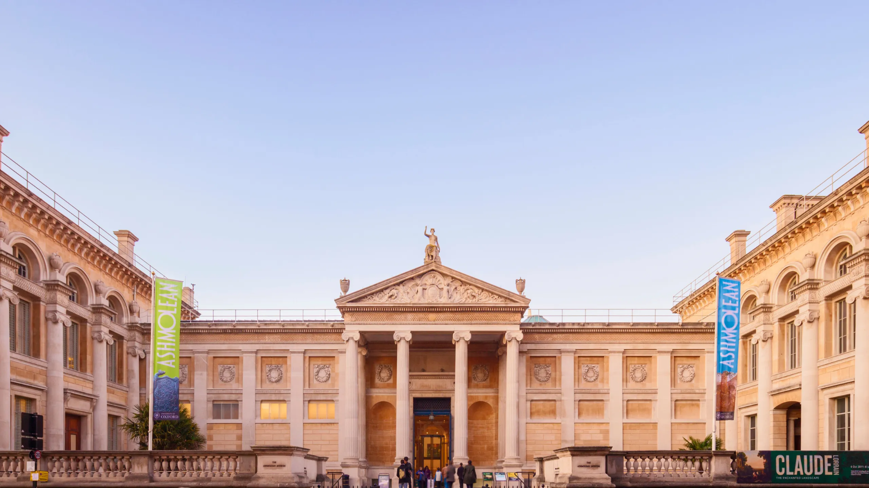

Slide 3
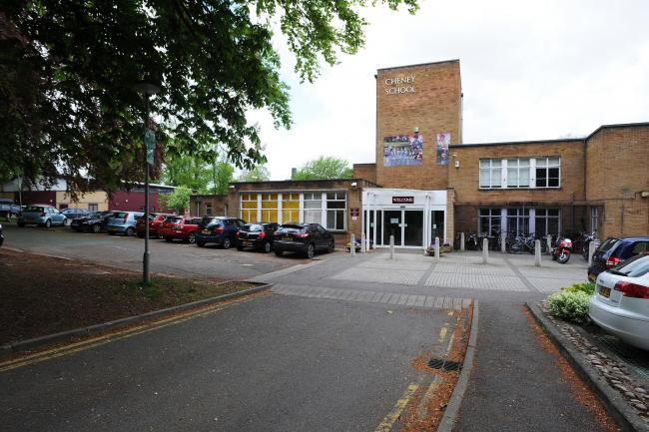

Slide 4
What makes a museum?
Make a list at your tables of the things you think museums have in common.
Notes:
This reinforces a discussion during the Gallery Hunt at the Ashmolean Museum.

Slide 5
Has a collection
Open to the public
Preserves objects – and ideas/stories
Collects objects
Interpret objects
Research
Education

Slide 6
In 1998, a group of people who work in and with museums called the Museums Association defined it as follows:
“Museums enable people to explore collections for inspiration, learning and enjoyment. They are institutions that collect, safeguard and make accessible artefacts and specimens, which they hold in trust for society. This definition includes art galleries with collections of works of art, as well as museums with historical collections of objects. ”

Slide 7
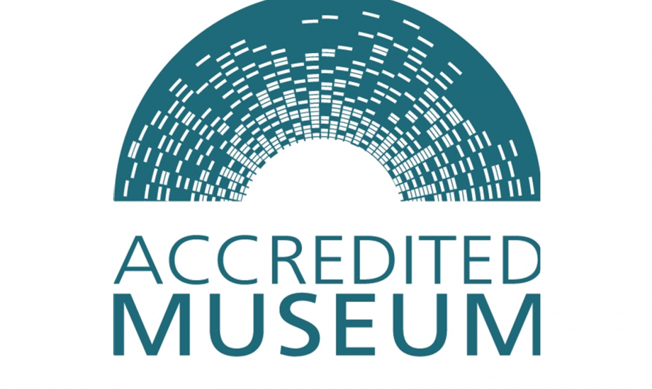

Slide 8
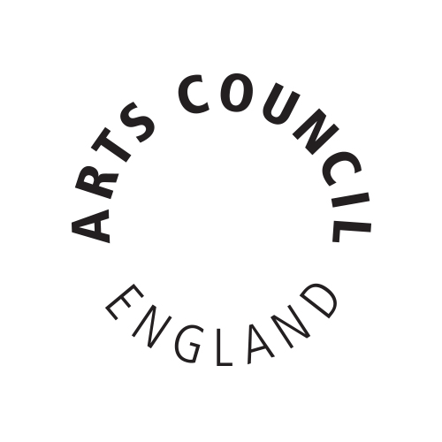

Slide 9
What are the objects in front of you?
Using the information sheets provided, please use your chromebooks to fill in information next to each object.
Each pair will explore one or two of the objects, depending on time.
The coin is an original ancient Greek coin - please where the gloves provided to handle it.

Slide 10
The Rumble Objects

Slide 11
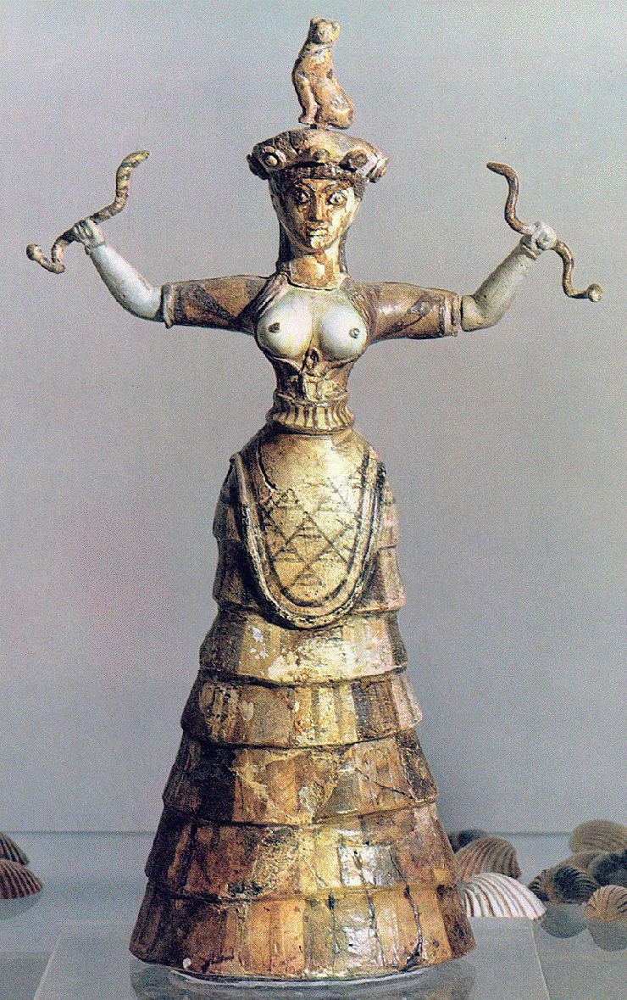

Slide 12
Snake goddess
Found in various sites in Crete dating to 1600 BC. It appears to represent a fertility goddess.

Slide 13
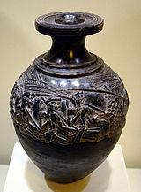

Slide 14
Harvester Vase
Found in Hagia Triada in Southern Crete. It appears to depict a harvest ritual celebration in detail – it includes a musical instrument called a “sistron”.

Slide 15
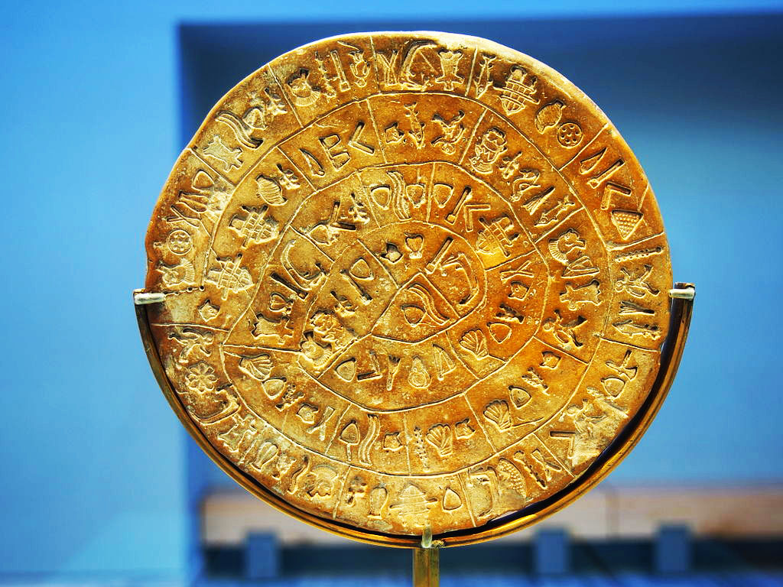

Slide 16
Phaistos Disc
Found in Phaistos, Crete, dating to 1700 BC.
There are plentiful theories about it, but no one really knows what it is, what it says or how it was used!

Slide 17
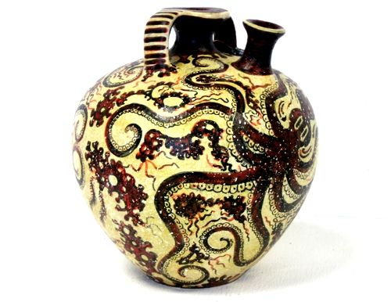

Slide 18
Octopus Jar
Found in Crete, dating to 1500 BC.
Its fluid octopus design was common in the late Bronze Age (around 1500BC) on Crete.

Slide 19
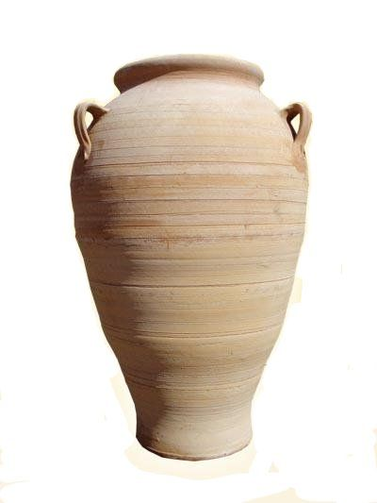

Slide 20
Pithos Jar
Found in Crete and related Bronze Age sites around 1500BC.
They were often as tall as a person, with handles for ropes in order for the containers to be lugged around.

Slide 21
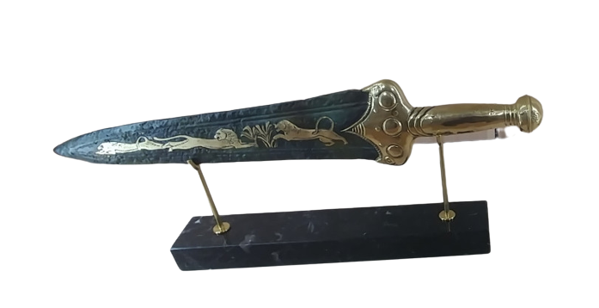

Slide 22
Dagger
Often found in the tombs of the Bronze Age Mycenaeans. The best known is the dagger from the Tomb IV, which represents a lion hunt.

Slide 23
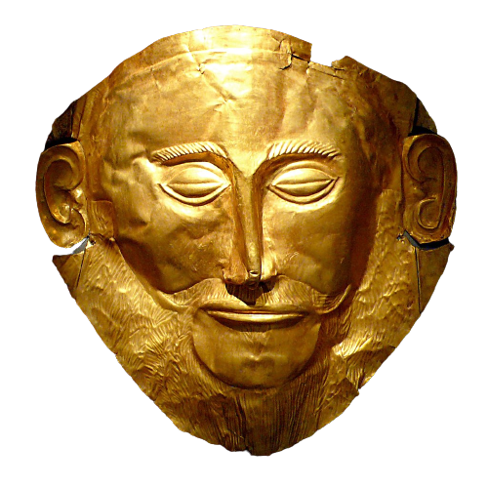

Slide 24
Mask of Agamemnon
Discovered at Mycenae in Greece in 1876, and was one of several gold funeral masks. These burial masks were placed over the faces of leaders who had been buried.

Slide 25
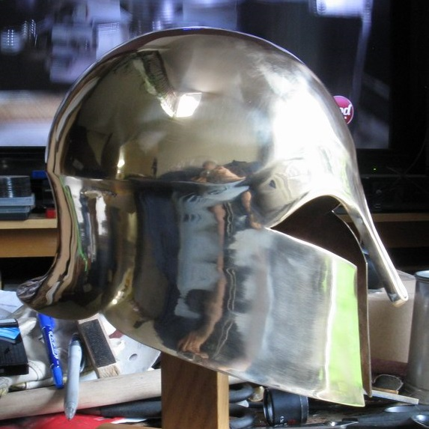

Slide 26
Corinthian Helmet
This type of helmet is known as a 'Corinthian helmet' by archaeologists because the goddess Athena is shown wearing it on Corinthian coins from its period of use (7th - 3rd Century BC). This style of helmet was also frequently featured on the decorative vases.

Slide 27
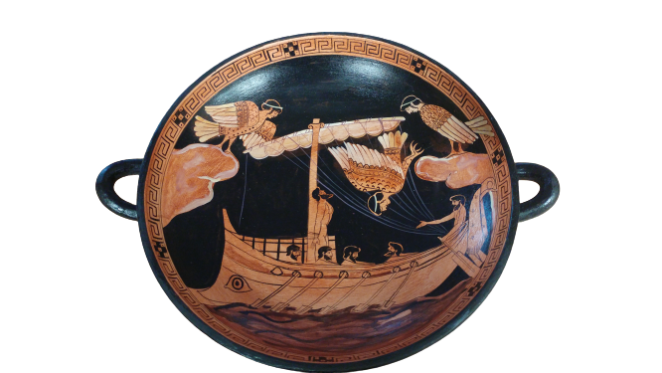

Slide 28
Kylix Cup
The kylix displays an image from the story of the Greek hero Odysseus passing the Sirens. The image appears on a stamnos (Greek vase) dating to the fifth century BC, which is currently in the British Museum. It was found in Italy. In the story Odysseus asks his sailors to tie him to the mast of the ship, while they plugged their ears with wax, so he can hear the Siren’s song.
A kylix is a type of Greek wine-drinking or wine-mixing cup. It was commonly used at a symposium (drinking party).

Slide 29
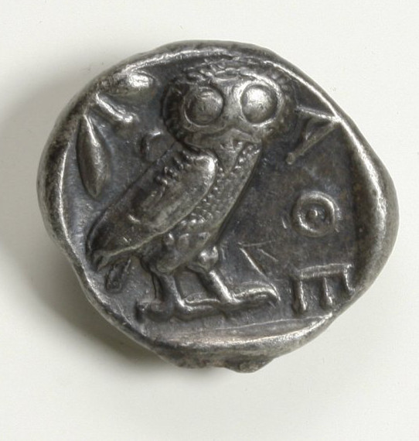

Slide 30
Tetradrachm Coin
The tetradrachm is an ancient Greek silver coin equivalent to four drachmae. It was in wide circulation from around 510 to around 38 BC. The Athenian tetradrachm was stamped with the head of the goddess Athena on the obverse. The reverse was stamped with the image of the owl of Athena, the symbol of the Athenian polis, with a sprig of olive and a crescent for the moon. It was known as glaux (γλαύξ, little owl) throughout the ancient world.
A tetradrachm was worth about four times a skilled worker’s daily wage, and could buy luxuries such as jewelry and horses.

Slide 31
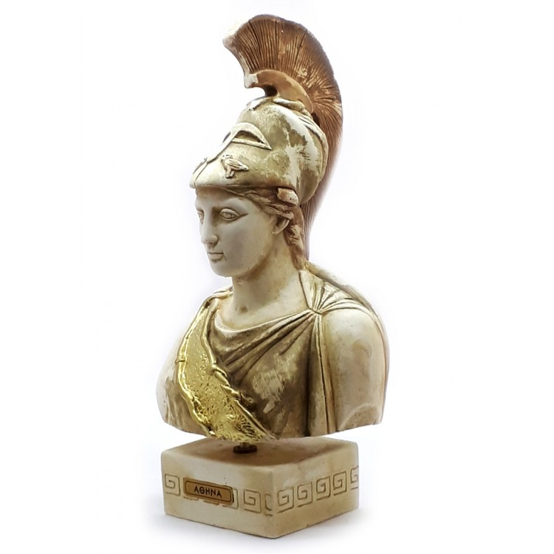

Slide 32
Bust of Athena
This bust is based on the famous sculpture known as "The Piraeus Athena", which is a bronze statue dated to the fourth century BC.
It currently resides in the Archaeological Museum of Piraeus. Athena is wearing a Corinthian helmet, which in fourth century B.C became very popular, as opposed to an Attic helmet where she is shown wearing in other sculptures. The helmet in the Piraeus Athena has griffins on each side of the crest, and two owls on the visor.

Slide 33
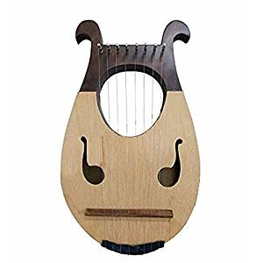

Slide 34
Wooden Lyre
Lyres were known to be used by the ancient Greeks, and were in many ways like miniature harps. A classical lyre has a hollow body which was made out of turtle shell. Bards and poets are often described or depicted in ancient Greek and Roman art and literature as playing a lyre while reciting poetry.

